Slide 1
Counters & Sketches
Itamar Cohen

Slide 2
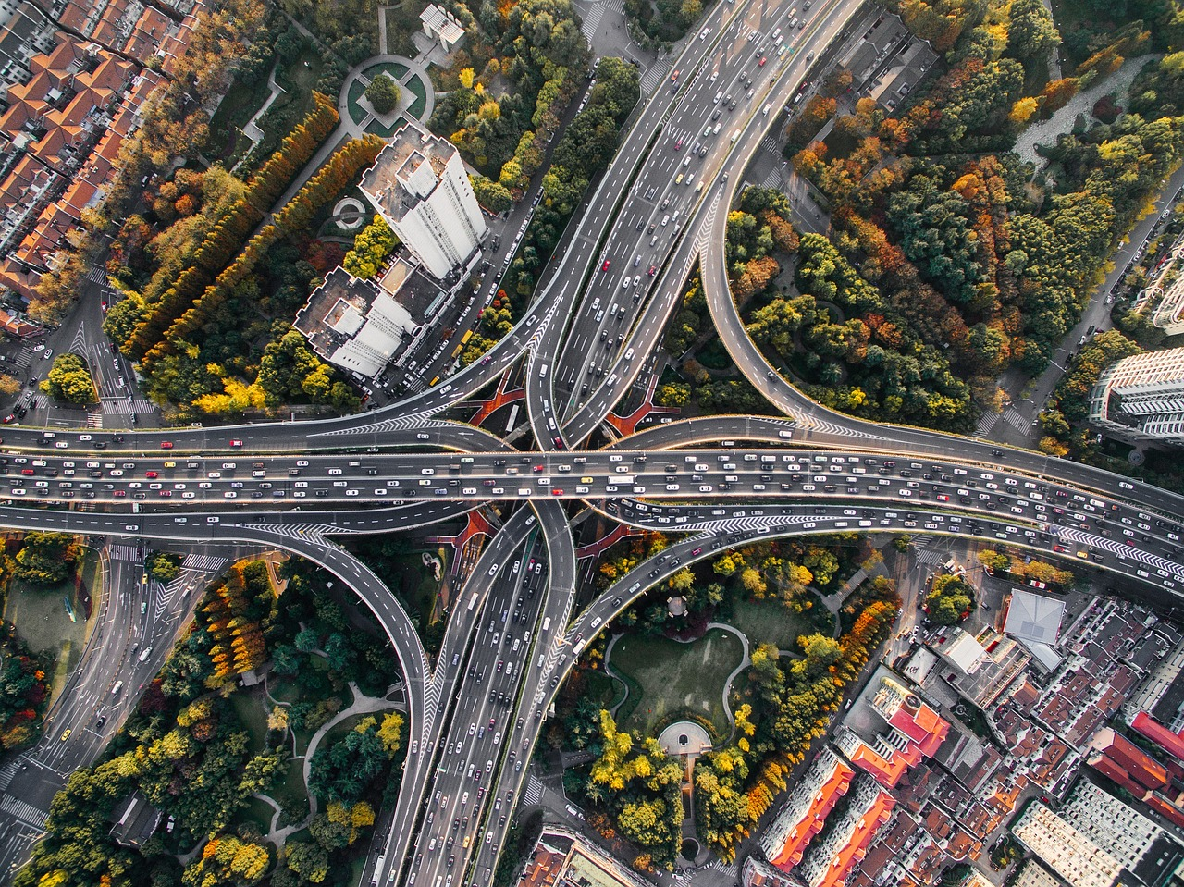
Motivation
Gather stat on vehicles’ colors
Counters & Sketches
Introduction
Counters
Sketches
Dyn. scaling
Summary

Slide 3
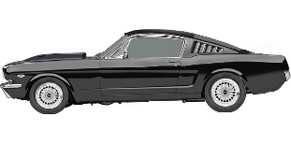
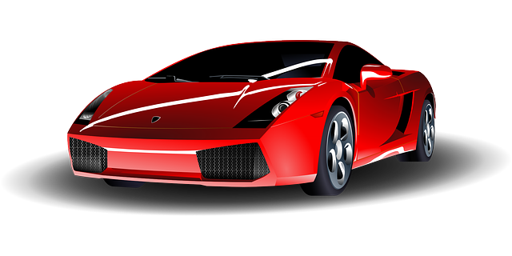
Possible approaches
Sample a single lane
☹ The sample may be biased
Counters & Sketches
Introduction
Counters
Sketches
Dyn. scaling
Summary

Slide 4
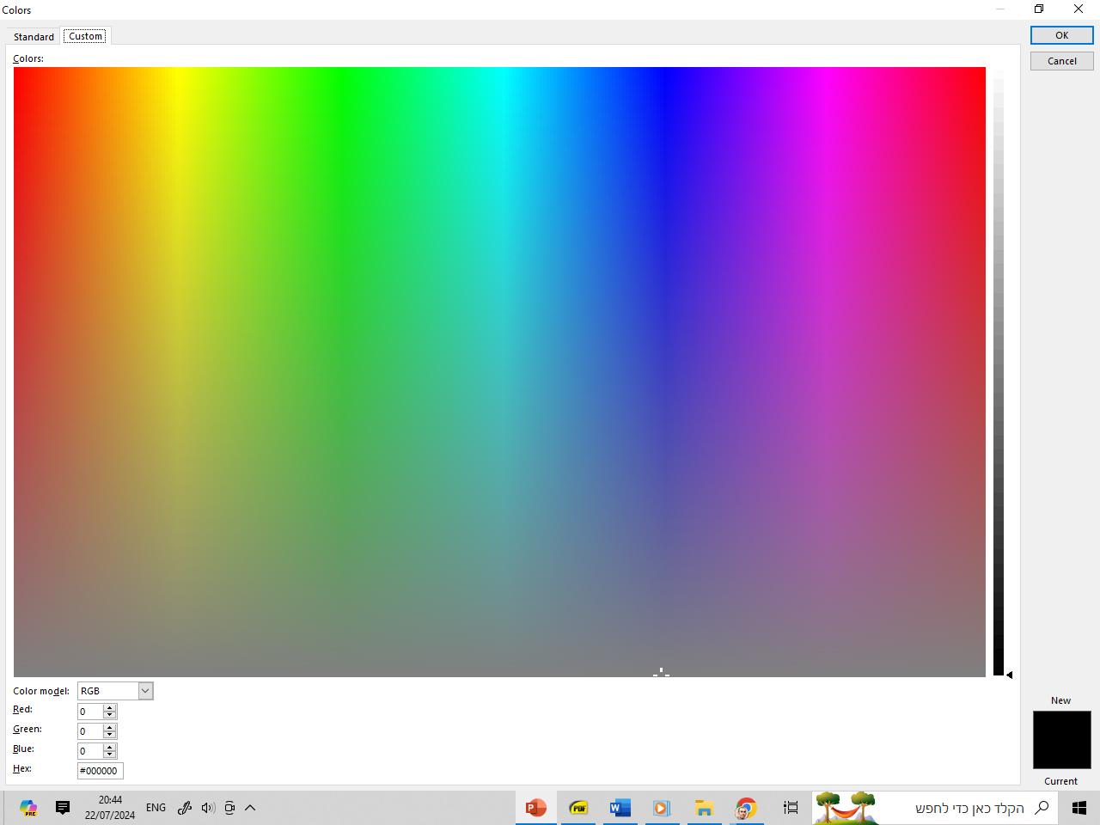
Possible approaches
Sample a single path
☹ The sample may be biased
Share counters of similar colors
Aka “hashing”
Approximate
Counters & Sketches
Introduction
Counters
Sketches
Dyn. scaling
Summary

Slide 5
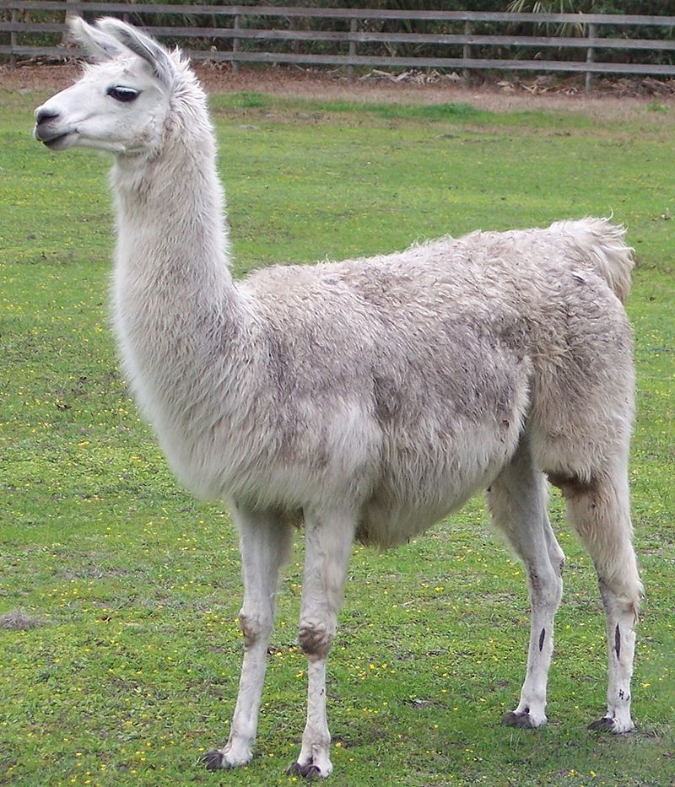
Motivation
Counters & Sketches
Introduction
Counters
Sketches
Dyn. scaling
Summary

Slide 6



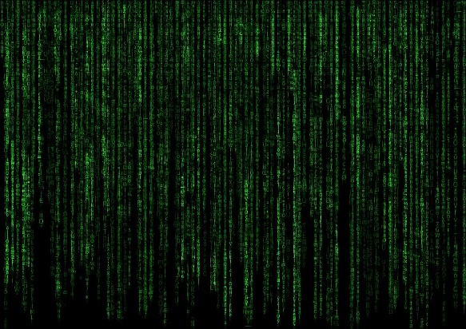
Motivation
Counters & Sketches
Introduction
Counters
Sketches
Dyn. scaling
Summary

Slide 7
Counters Vs. Sketches
Counters
Representing a large range using few bits
E.g., count up to 1G using 1B
Sketch (or $)
Measure many values by a few counters
E.g., 1M measurements using 1K counters
Dynamic scaling
What to do upon overflow
Counters & Sketches
Introduction
Counters
Sketches
Dyn. scaling
Summary
Notes:
Other approaches
SRAM/DRAM [CASE, SRAM_OF]
Compression [Braid]

Slide 8

Scalable counters [Pyramid, Tree]
Counters & Sketches
01
0000
0000
1111
0011
0001
0000
Introduction
Counters
Sketches
Dyn. scaling
Summary

Slide 9
Scalable counters [SALSA]
Counters & Sketches
0000
0000
0000
0000
Introduction
Counters
Sketches
Dyn. scaling
Summary
0000
0000
0000
0000

Slide 10
Scalable counters [SALSA]
Counters & Sketches
0000
0000
0000
0000
Introduction
Counters
Sketches
Dyn. scaling
Summary
0000
0000
0000
0001

Slide 11
Scalable counters [SALSA]
…
Counters & Sketches
Introduction
Counters
Sketches
Dyn. scaling
Summary

Slide 12
Scalable counters [SALSA]
0100
0000
0000
0011
Introduction
Counters
Sketches
Dyn. scaling
Summary
0010
0001
0101
0001

Slide 13
Scalable counters [SALSA]
…
Counters & Sketches
Introduction
Counters
Sketches
Dyn. scaling
Summary

Slide 14
Scalable counters
Counters & Sketches
0100
0000
0000
0011
Introduction
Counters
Sketches
Dyn. scaling
Summary
0010
0001
1111
0001

Slide 15
Scalable counters
Counters & Sketches
0100
0000
0000
0011
Introduction
Counters
Sketches
Dyn. scaling
Summary
0010
0001
0001 0000

Slide 16
Scalable counters
Counters & Sketches
☹ NUMA
☹ Many background ops
Introduction
Counters
Sketches
Dyn. scaling
Summary

Slide 17
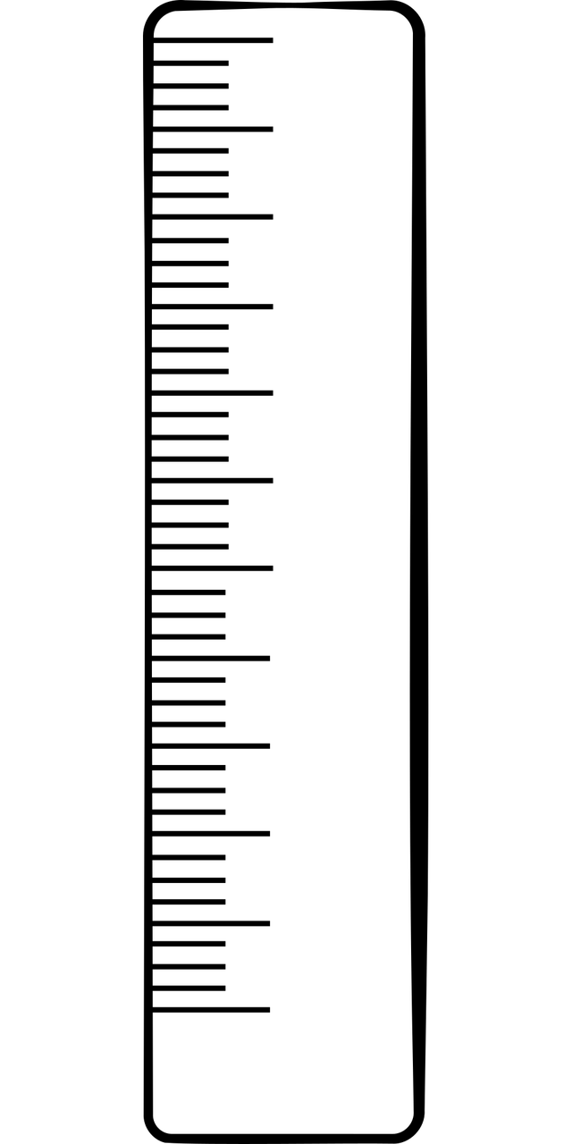

Estimators
Counters & Sketches
Select $2^{n}$ points within the range
Use probabilistic increments
EXPLAIN HERE what it is
Introduction
Counters
Sketches
Dyn. scaling
Summary

Slide 18
Estimators
Counters & Sketches
Logarithmic/optimized grid [Morris, CEDAR]
☹ Do not minimize query errors
☹ Irregular representation & ops
Introduction
Counters
Sketches
Dyn. scaling
Summary

Slide 19
Estimators
Counters & Sketches
Linear grid [AEE]
☺ Fixed increment probability
☹ High relative error for mice
Introduction
Counters
Sketches
Dyn. scaling
Summary

Slide 20
FP-based representations
Fixed exponent size [FP8, BF16, TF32]
☹ Tradeoff accuracy for counting range
Floating exponent size [SEAD]
☹ Small counting range
☹ Represents only integers
☹ Irregular representation & ops
Counters & Sketches
Introduction
Counters
Sketches
Dyn. scaling
Summary

Slide 21
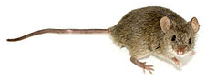
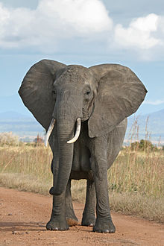
Our contribution: Floating Floating Point (F2P)
Similar to standard FP representation
Easier to implement on standard HW
Multiple flavors
Enhanced accuracy on a chosen range
Mice / elephants
Represent reals / integers
Counters & Sketches
Introduction
Counters
Sketches
Dyn. scaling
Summary

Slide 22
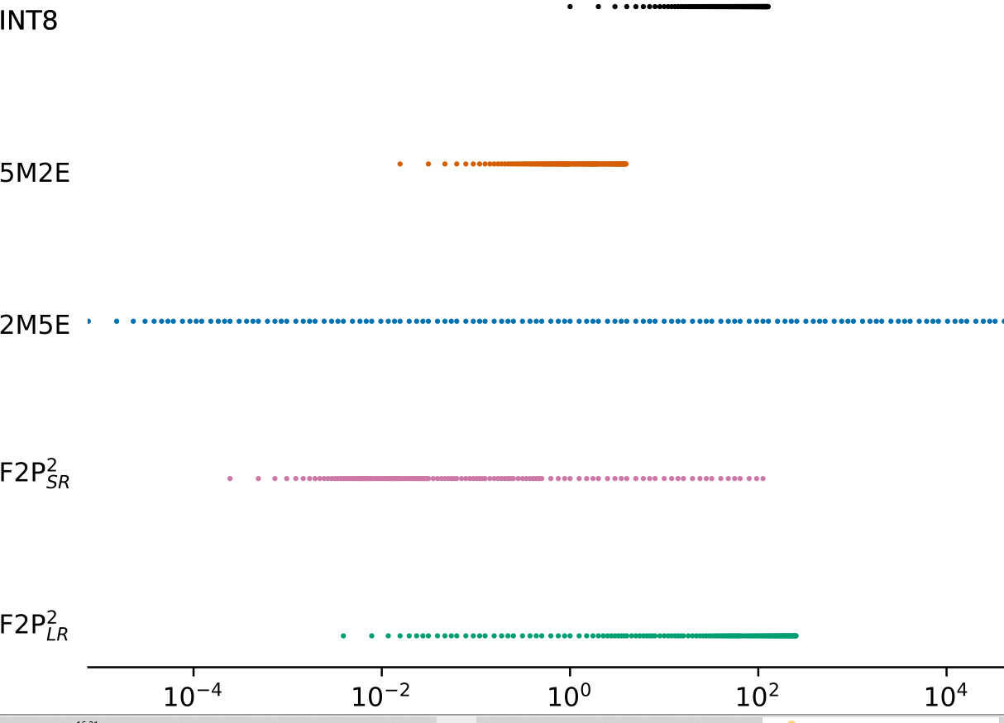
Comparison of 8-bits # systems
Counters & Sketches
Introduction
Counters
Sketches
Dyn. scaling
Summary

Slide 23
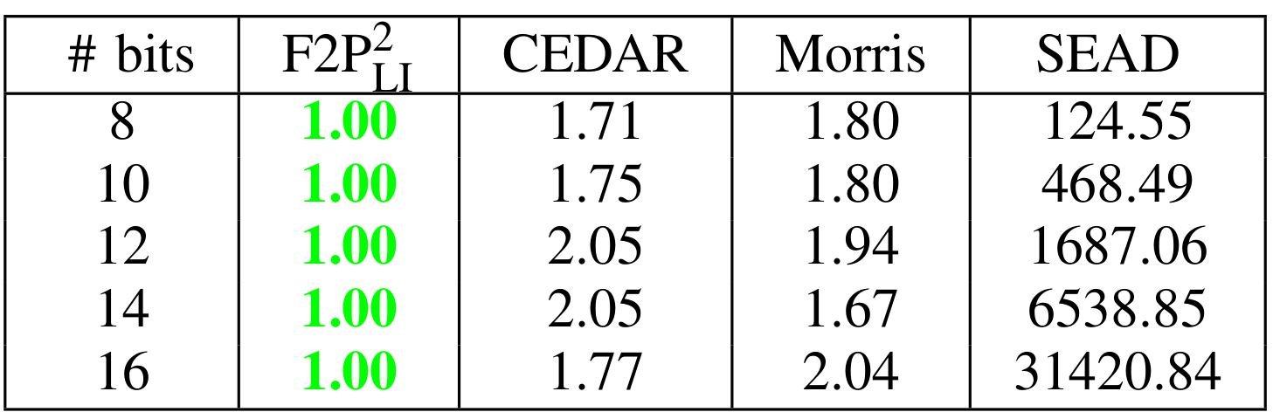
Floating Floating Point (F2P): single counter simulations
Counters & Sketches
Introduction
Counters
Sketches
Dyn. scaling
Summary

Slide 24
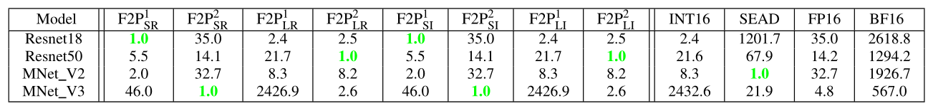
Floating Floating Point (F2P): Applying for ML
Counters & Sketches
Introduction
Counters
Sketches
Dyn. scaling
Summary

Slide 25
Count Min Sketch
Counters & Sketches
1
0
5
2
3
3
2
1
8
2
Key=777
Introduction
Counters
Sketches
Dyn. scaling
Summary
1
7
2
4
3
Estimation ← min (5,2,1) = 1

Slide 26
Count Min Sketch
Counters & Sketches
1
0
6
2
3
3
3
1
8
2
Key=777
Introduction
Counters
Sketches
Dyn. scaling
Summary
2
7
2
4
3
Increment the hashed counters

Slide 27
Space Saving $
Counters & Sketches
111
501
666
222
007
Keys
Vals
3
3
1
8
2
Key=007
Introduction
Counters
Sketches
Dyn. scaling
Summary
If the key is in the $
Estimate

Slide 28
Space Saving $
Counters & Sketches
111
501
666
222
007
Keys
Vals
3
3
1
8
3
Key=007
Introduction
Counters
Sketches
Dyn. scaling
Summary
If the key is in the $
Estimate
Inc. cntr

Slide 29
Space Saving $
Counters & Sketches
111
501
666
222
007
Keys
Vals
3
3
1
8
3
Key=777
Introduction
Counters
Sketches
Dyn. scaling
Summary
If the key is in the $
Estimate
Inc. cntr
Else
Insert the new key, evict smallest cntr
Apply the smallest counter value + 1

Slide 30
Space Saving $
Counters & Sketches
111
501
777
222
007
Keys
Vals
3
3
2
8
3
Key=777
Introduction
Counters
Sketches
Summary
If the key is in the $
Estimate
Inc. cntr
Else
Insert the new key, evict smallest cntr
Apply the smallest counter value + 1

Slide 31
Dynamic Scaling
Upon OF, scale all counters [CEDAR, AEE]
☹ Complex scaling mechanism
May be amortized
Detail the up-scaling here
Counters & Sketches
Introduction
Counters
Sketches
Dyn. scaling
Summary

Slide 32
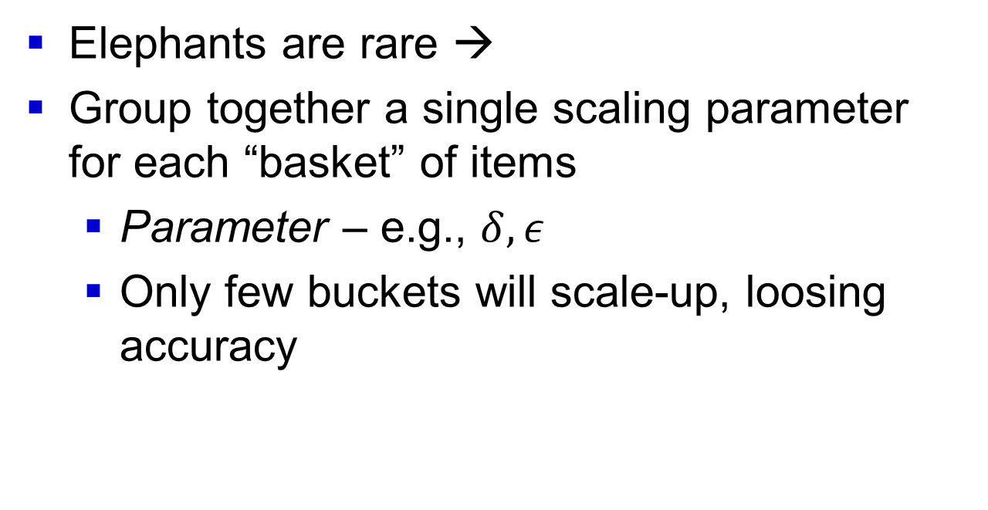
Dynamic Scaling using buckets: intuition
Counters & Sketches
Elephants are rare →
Group together a single scaling parameter for each “basket” of items
Parameter – e.g., $δ, ε$
Only few buckets will scale-up, loosing accuracy
Introduction
Counters
Sketches
Dyn. scaling
Summary

Slide 33
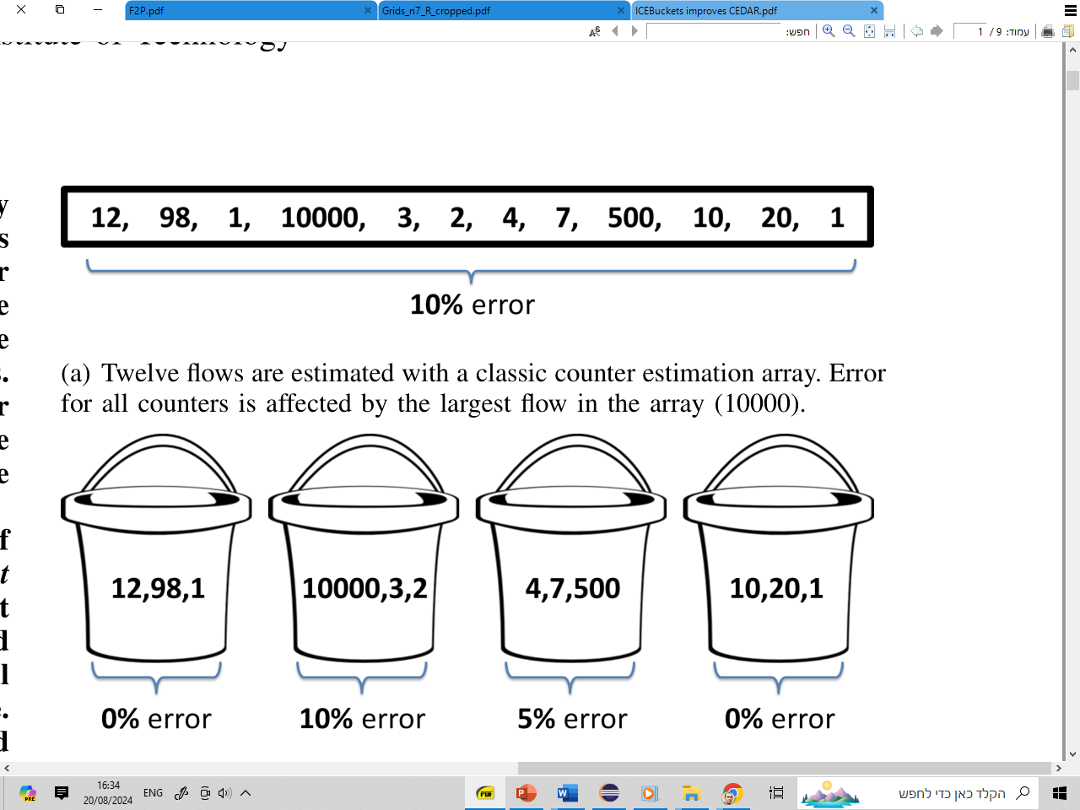
Dynamic Scaling using buckets Detail the up-scaling here
Counters & Sketches
Introduction
Counters
Sketches
Dyn. scaling
Summary
Figs. taken from [ICE]

Slide 34





Scalable Exponent Counters Dynamic Scaling using buckets Detail the up-scaling here
Counters & Sketches
$N=M⋅2^{E}, M=1,2,…, 255 →E$= 6
Introduction
Counters
Sketches
Dyn. scaling
Summary
$E$= 0
$E$= 6
$E$= 1
$E$= 0
Figs. taken from [ICE]

Slide 35
Down sampling
Down-sampling [AEE]
Init: sample each packet w.p. 1
Upon overflow
Half all counters
Half the sampling probability
Counters & Sketches
Introduction
Counters
Sketches
Dyn. scaling
Summary

Slide 36
Summary
“Orthogonal” design choices
(single) counter
Sketch
Dynamic scaling
Multiple (possibly conflicting) opt’ criteria
Absolute/relative error
HW/SW compatibility
Timing, area, power
“Typical” distribution
Counters & Sketches
Introduction
Counters
Sketches
Dyn. scaling
Summary

Slide 37

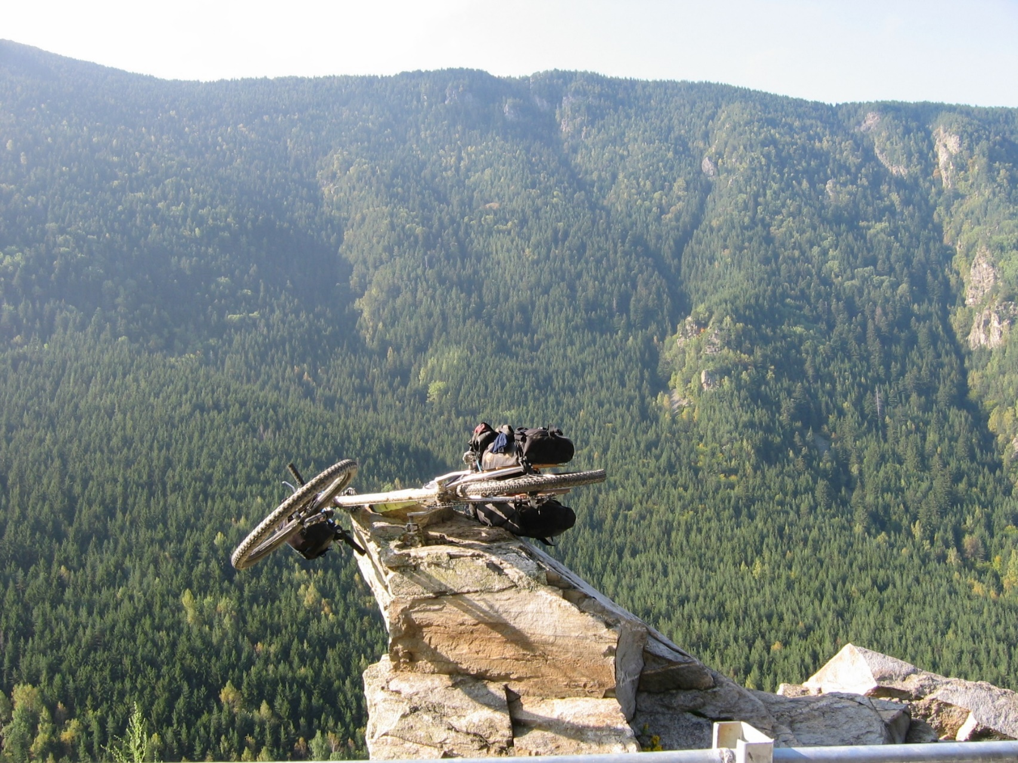
Questions / useful contacts
Counters & Sketches
ofanan@gmail.com
Introduction
Counters
Sketches
Dyn. scaling
Summary

Slide 38
References
[CASE] Li, Yang, et al. "Case: Cache-assisted stretchable estimator for high speed per-flow measurement." in IEEE INFOCOM, 2016.
[SRAM_OF] Zhao, Qi, Jun Xu, and Zhen Liu. "Design of a novel statistics counter architecture with optimal space and time efficiency." in the joint international conference on easurement and modeling of computer systems. 2006.
[Braids] Y. Lu, A. Montanari, B. Prabhakar, S. Dharmapurikar, and A. Kabbani, “Counter braids: a novel counter architecture for per-flow measurement,” ACM SIGMETRICS Performance Evaluation Review, vol. 36(1)1, pp. 121–132, 2008.
[Pyramid] Yang, Tong, et al. "Pyramid sketch: A sketch framework for frequency estimation of data streams." in VLDB Endowment 10.11 (2017): 1442-1453.
[SALSA] Basat, Ran Ben, et al. "Salsa: self-adjusting lean streaming analytics." in IEEE International Conference on Data Engineering (ICDE), 2021.
[ICE] Einziger, Gil, et al. "Ice buckets: Improved counter estimation for network measurement." IEEE/ACM TNet 26.3 (2018): 1165-1178.

Slide 39
References
[Morris] Morris, Robert. "Counting large numbers of events in small registers." Communications of the ACM 21.10 (1978): 840-842.
[CEDAR] Tsidon, Erez, Iddo Hanniel, and Isaac Keslassy. "Estimators also need shared values to grow together." in IEEE INFOCOM, 2012.
[AEE] Basat, Ran Ben, et al. "Faster and more accurate measurement through additive-error counters." in IEEE INFOCOM, 2020.
[FP8] A. Kuzmin, M. Van Baalen, Y. Ren, M. Nagel, J. Peters, and
T. Blankevoort, “Fp8 quantization: The power of the exponent,”
Advances in Neural Information Processing Systems, vol. 35, pp. 14 651–
14 662, 2022.
[BF16] “The bfloat16 numerical format.” [Online]. Available:
https://cloud.google.com/tpu/docs/bfloat16
[TF32] “Tensorfloat-32 in the a100 GPU accelerates AI training, HPC up
To 20x.” [Online]. Available:
https://blogs.nvidia.com/blog/tensorfloat-32-precision-format/

